Slide 1
Hepatitis C Virus
From Discovery to Cure
David R Nelson MD
Assistant Vice President for Research
Professor of Medicine
Director, Clinical and Translational Science Institute
University of Florida
Gainesville, USA

Slide 2
Disclosures
David R Nelson, MD,
Research support from AbbVie, Bristol-Myers Squibb, Genentech/Roche, Gilead Sciences, Merck, Janssen, and Vertex
Additional research support: NIH, DOD, DOH, PCORI grants

Slide 3
Outline
HCV discovery
Epidemiology and disease burden
  Prevalence and natural history
  Impact of morbidity and mortality
  Impact of viral eradication
Building an interferon-free future
  The beginning of the end
Linkage to care

Slide 4
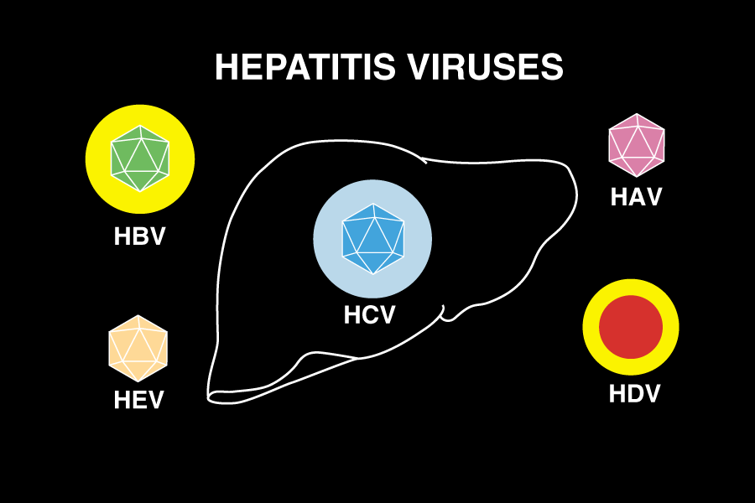
History of Viral Hepatitis
Blumberg and Alter, 1965
Feinstone, Kapikian & Purcell, 1973
Still large numbers of hepatitis that was not explained by A and B

Slide 5
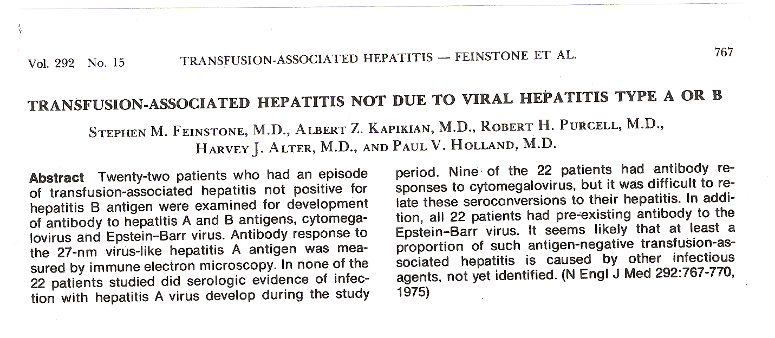
The New Era of Non-A Non-B Hepatitis
NEJM 1975

Slide 6
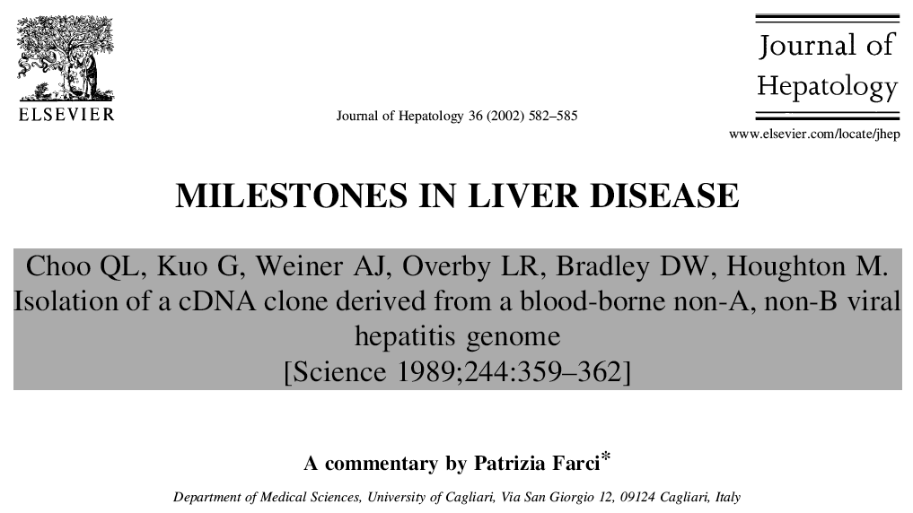
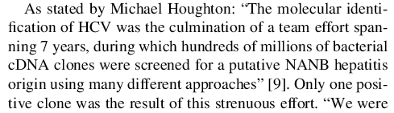
….
….
HCV was the first virus to be isolated and characterized solely by molecular methods (ie without culture methods)
Notes:
6

Slide 7
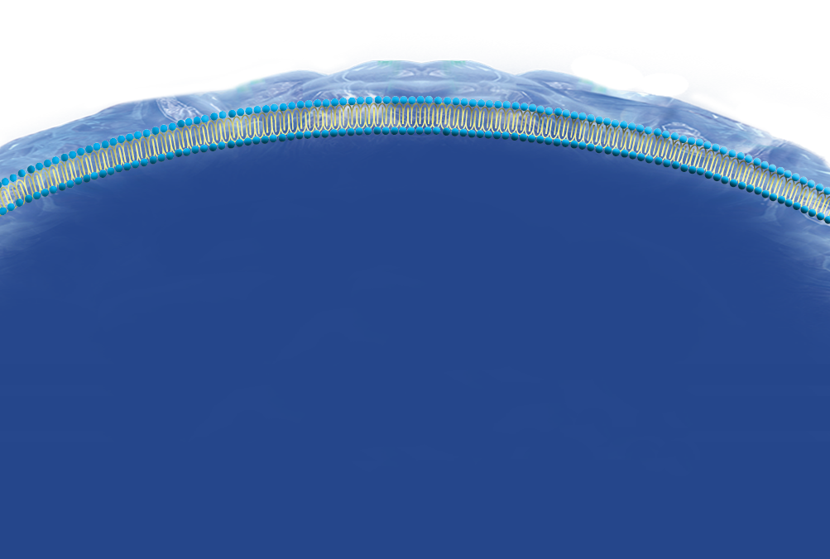









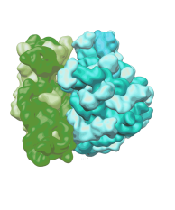



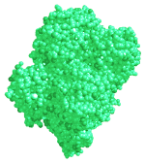








Viral Life Cycle and Development of Direct Acting Antivirals
Transport and release
Entry and p7 inhibitors
Fusion and uncoating
α-glucosidase inhibitors
Viral assembly
HCV RNA
Translation
IRES inhibitors
RNA replication
NS5B polymerase inhibitors
Cyclophilin Inhibitors
Polyprotein processing
CypA
NS3
NS5B
NS5A
NS4B
NS2
NS4B
NS2
NS3
NS5A
NS5B
NS4B and NS5A inhibitors
NS3/4A protease inhibitors
HCV NS proteins
Notes:
HCV enters the host cell cytoplasm via a fusion process between viral and cellular membranes.
Uncoating of the virus releases positive-strand viral RNA into the host cell cytoplasm. This RNA is then used to synthesise a viral polyprotein, using host cell ribosomes and translational cofactors.
The viral polyprotein is cleaved by host proteases and viral proteases into structural and nonstructural (NS) proteins.
The NS proteins form the viral replication complex, which uses viral RNA as a template to synthesize new viral mRNA
The new viral RNA is packaged to form new virions in the endoplasmic reticulum
The virus matures in the Golgi apparatus and is released by exocytosis as new virions
[Note to client: we will highlight an overview of the lifecycle of the virus (as above) using colours to differentiate host/viral proteins and cofactors. Using animation, colours, and lighting techniques (to be artworked in New Year), the different MoAs of HCV therapies will be highlighted at the different stages of the life cycle, with emphasis on the difference between host and viral targets]

Slide 8
Cure Rates for Chronic Hepatitis C Therapy
Direct Acting Antivirals
2nd Gen
DAAs
Protease inhibitor
2013
2011
Peginterferon
2001
Ribavirin
1998
SVR (%)
Standard
Interferon
1991
6 Months
12 Months
6 Months
12 Months
12 Months
6-12 Months
12 weeks
IFN
IFN + RBV
PegIFN
+ RBV
PegIFN+ RBV+PI
IFN-Free

Slide 9
HCV Epidemiology and Disease Burden

Slide 10
Seroprevalence of Hepatitis C:
170 to 200 Million Worldwide
Eastern Europe
10 M
Western Pacific
60 M
United States
5M
Western Europe
5 M
Highest Prevalence: Egypt-4M
(45% adults >40y)
Southeast Asia
30-35 M
Americas
12-15 M
Africa
30-40M
Australia
.2 M
1. World Health Organization. Wkly Epidemiol Rec. 2000;75:17-28.
2. Edlin B et al. AASLD; November 11-15; 2005 San Francisco, California. Oral Presentation #44.
P-DS-D-159
Notes:
10

Slide 11
Over 5.2 Million People Living With
Chronic HCV in the US
Conservative estimate
Upper limit of estimate
7.1
5.2
Number of HCV Cases (millions)
3.8
3.2
1.9
NHANES
Estimate
HCV Cases Not Included in NHANES*
Estimated
Total HCV Cases
*Homeless (n=142,761-337,6100); incarcerated (n=372,754-664,826); veterans (n=1,237,461-2,452,006); active military (n=6805);
healthcare workers (n=64,809-259,234); nursing home residents (n=63,609); chronic hemodialysis (n=20,578); hemophiliacs
(n=12,971-17,000).
Chak E, et al. Liver Int. 2011; 31:1090-1101.
Notes:
Slide: Over 5.2 Million People Living With Chronic HCV in the US
The National Health and Nutrition Examination Survey (NHANES) estimates there are 3.2 million persons in the United States who are chronically infected with HCV. However, this figure is an underestimation since the survey did not account for incarcerated or homeless persons.¹
Chak and colleagues searched the MEDLINE database for all epidemiologic studies on HCV prevalence to estimate chronic HCV cases in the United States not accounted for in NHANES. The most conservative estimate yielded an additional 1.9 million chronic HCV cases, bringing the total to at least 5.2 million. This would correlate to a 2% prevalence.¹
Reference
Chak E, Tala AH, Sherman KE, et al. Hepatitis C virus infection in the USA: an estimate of true prevalence. Liver Int. 2011;31:1090-1101.

Slide 12
Chronic HCV in the US:
Underdiagnosed and Untreated
Unaware of Infection
Number (in ‘000s)
38%
Diagnosed
5.5%
Treated
Prevalence
Diagnosed
Treated
Hepatitis C Monitor. Ipsos Healthcare.
Notes:
Slide: Chronic HCV in the US: Underdiagnosed and Untreated
Prior to and immediately after the approval of boceprevir and telaprevir, only 38% of patients with HCV infection were diagnosed, and HCV treaters managed only 5.5% of chronic HCV patients. These data underscore the fact that HCV in the United States has historically been underdiagnosed and undertreated.

Slide 13
Baby Boomers (Born in 1945–1965) Account for 76.5% of HCV in the US¹
Estimated Prevalence by Age Group²
1.6
1.4
1.2
1.0
Number with chronic HCV (millions)
0.8
0.6
0.4
0.2
0
<1920
1920s
1930s
1940s
1950s
1960s
1970s
1980s
1990+
Birth Year Group
An estimated 35% of undiagnosed baby boomers with HCV currently have advanced fibrosis (F3-F4; bridging fibrosis to cirrhosis)³
1. Centers for Disease Control and Prevention. MMWR. 2012;61:1-32; Adapted from Pyenson B, et al. Consequences of Hepatitis C Virus (HCV): Costs of a baby boomer Epidemic of Liver Disease. New York, NY: Milliman, Inc; May 18, 2009. http://www.milliman.com/expertise/healthcare/publications/rr/consequences-hepatitis-c-virus-RR05-15-09.php Milliman report was commissioned by Vertex Pharmaceuticals; 3. McGarry LJ et al. Hepatology. 2012;55(5):1344-1355.

Slide 14
Rationale for Birth Cohort Screening
65.6% of all infected persons in the U.S. were born between 1945-1964
  Overall prevalence, 4.3%
  Men 6.2%
  Black Americans, 9.4%
  Black American men, 13.6%
In 2013, U.S. Preventative Services Task Force recommends
  Screening in persons at high risk for infection (Grade A)
  One time screening in persons born between 1945-1965 (Grade B)
Armstrong, et al. Ann Intern Med. 2006.

Slide 15
Recommended Laboratory Tests for
Chronic HCV Infection
 | Test Application
Hepatitis C antibody by enzyme immunoassay (EIA) | Screening for past or present HCV infection Sensitive and inexpensive
PCR for HCV RNA | Confirmation of positive EIA Medical evaluation and management
AASLD and IDSA. http://www.hcvguidelines.org/full-report-view. Version August 7, 2015.
Notes:
Slide: Recommended Laboratory Tests for Chronic HCV Infection
Tests that detect HCV antibody by enzyme immunoassay (EIA) are recommended for both screening and diagnosis. Positive results are to confirmed using PCR for HCV RNA.¹
Reference
AASLD and IDSA. Recommendations for testing, managing, and treating hepatitis C. http://www.hcvguidelines.org/full-report-view. Version August 7, 2015.

Slide 16
Markers for Chronic HCV Infection
HCV RNA
Symptoms +/-
Total Ant-HCV
Antibodies
ALT
Titer
ULN
0 4 8 12 16 20 36 48 96 144 192
Weeks After Infection
Chevaliez S, et al. Liver Int. 2009;29:9-16.
Notes:
Slide: Markers for Chronic HCV Infection
In chronic HCV infection, HCV RNA is elevated for years as well as HCV antibodies. Liver enzyme elevations are intermittent in the majority of individuals and are not a reliable indicator for detection of chronic HCV infection.¹
Reference
Chevaliez S, Pawlotsky JM. How to use virological tools for optimal management of chronic hepatitis C. Liver Int. 2009;29(suppl 1):9-14.

Slide 17
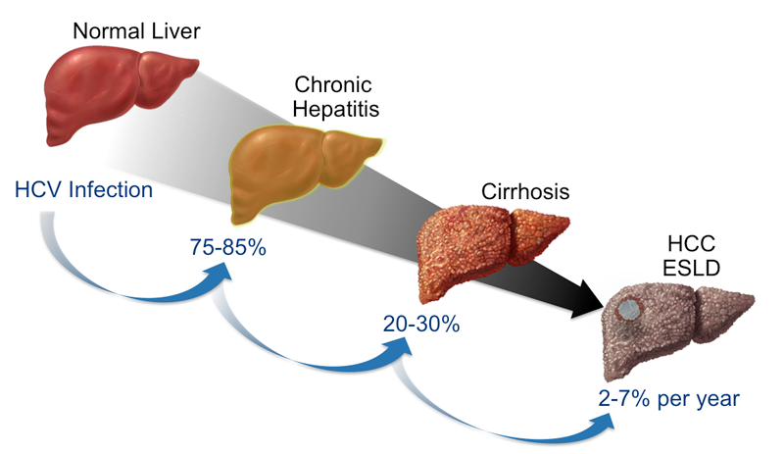



The Burden of Hepatitis C
Burden of Liver Disease
Patient Burden
Burden on Society
Notes:
What I’d like to do today is explore the influence of therapy on the burden of hepatitis C.

Slide 18
Increased Morbidity and Mortality
Due to HCV Now and in the Future
Mortality Rates of HBV, HCV and HIV: 1999-2007¹
Morbidity and Mortality
Predictions²
2016
2032
By 2007 hepatitis C-associated deaths had overtaken HIV as a cause of mortality in the United States.
New policies and commitments to detect and link infected persons to care and successful treatment are needed.
DCC, decompensated cirrhosis
Adapted from Ly KN et al. Ann Intern Med. 2012;156:271-278.
Adapted from Rein DB et al. Dig Liver Dis. 2011;43:66-72.

Slide 19
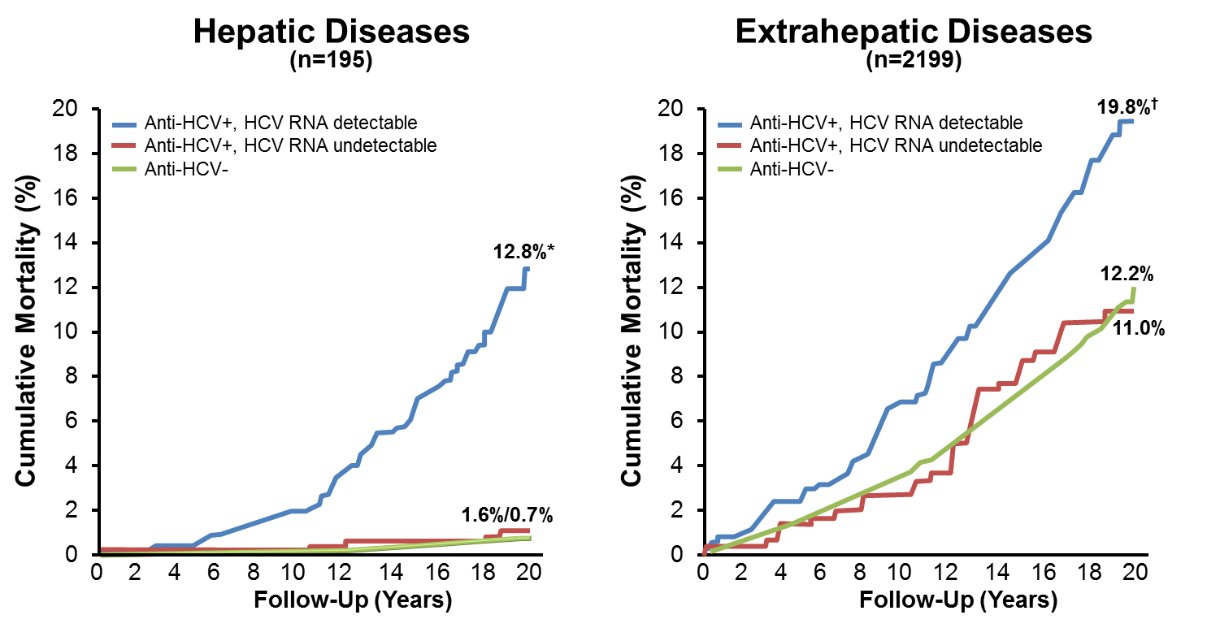
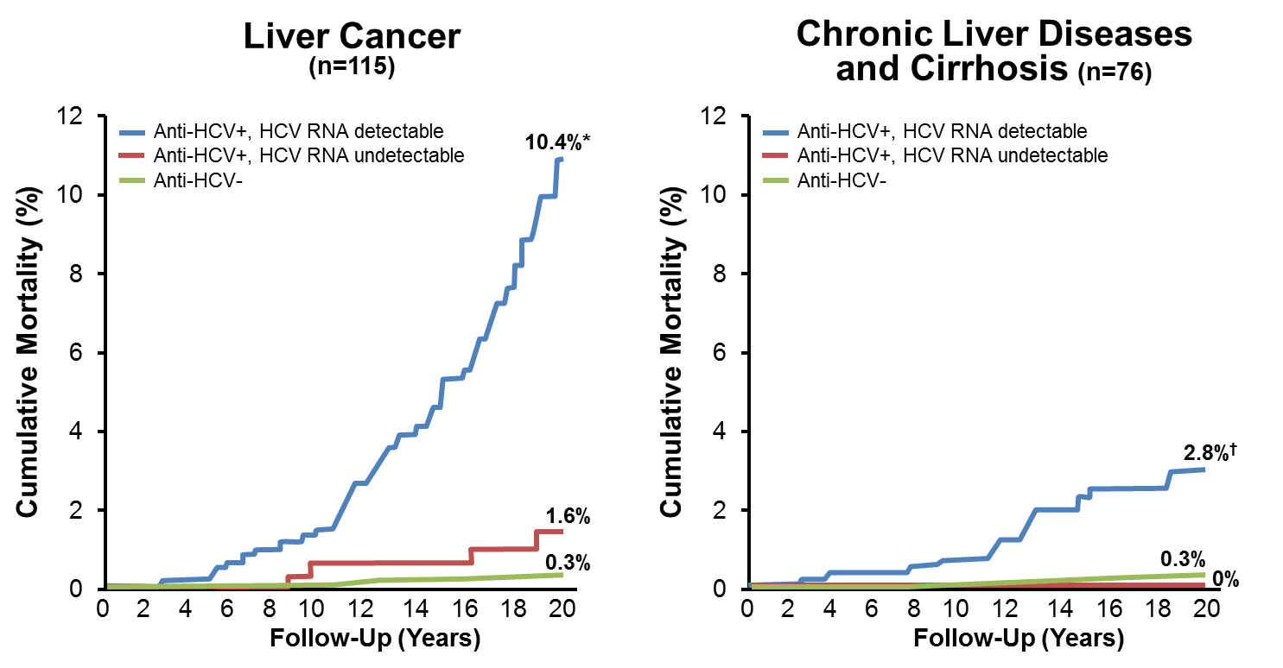
Increased Mortality from Liver Cancer and Chronic Liver Diseases in HCV: REVEAL-HCV Study
Lee M-H et al, 2012.

Slide 20
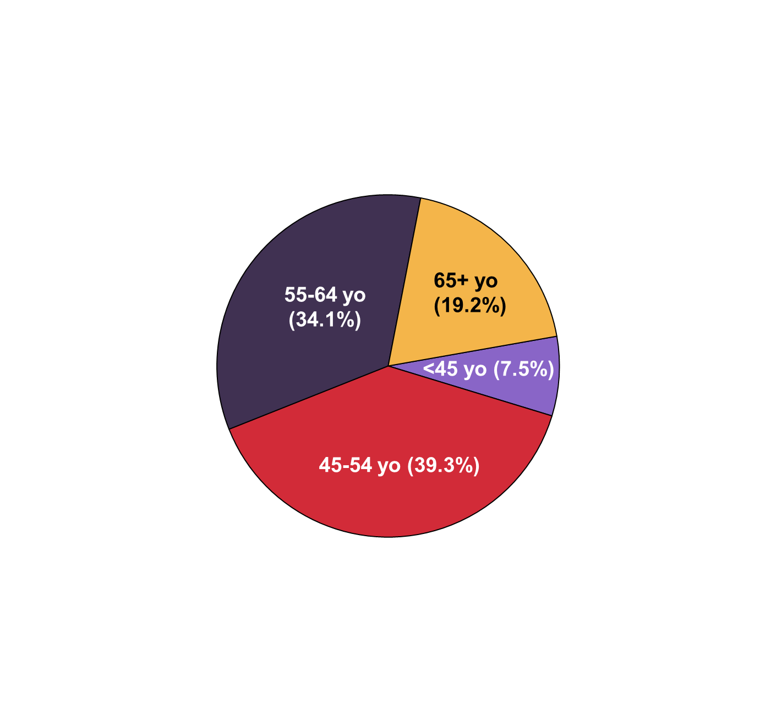
Deaths from HCV in the United States in 2007 (n=15,106)*
Individuals 45 to 64 Years of Age Most Affected
*Hepatitis C either contributing or underlying cause of death
Ly KN et al. Ann Intern Med 2012;156:271-278.

Slide 21
Achieving a Sustained Virologic Response (Cure) Associated With Improved Outcomes
Sustained viral response
  Durable
    99% stay HCV negative for >10 years
  Leads to improved histology
  Leads to clinical benefits
  Decreased decompensation
  Prevents de novo esophageal varices
  Decreased hepatocellular carcinoma
  Decreased mortality
Bruno S, et al. Hepatology. 2010;51:2069-2076.; Veldt BJ, et al. Ann Intern Med. 2007;147:677-684.; Maylin S, et al. Gastroenterology. 2008;135:821-829.
Notes:
Slide: Achieving a Sustained Virologic Response is Associated With Improved Outcomes
Achieving a sustained viral response is durable (99% stay HCV negative for >10 years); leads to improved histology and clinical benefits; prevents de novo esophageal varices; and decreases decompensation, hepatocellular carcinoma, and mortality.¹⁻³
References
Bruno S, Crosignani A, Facciotto C, et al. Sustained virologic response prevents the development of esophageal varices in compensated, Child-Pugh class A hepatitis C virus-induced cirrhosis. A 12-year prospective follow-up study. Hepatology. 2010;51:2069-2076.
Veldt BJ, Heathcote EJ, Wedemeyer H, et al. Sustained virologic response and clinical outcomes in patients with chronic hepatitis C and advanced fibrosis. Ann Intern Med. 2007;147:677-684.
Maylin S, Martinot-Peignoux M, Ripault MP, et al. Sustained virological response is associated with clearance of hepatitis C virus RNA and a decrease in hepatitis C virus antibody. Liver Int. 2009;29:511-517.

Slide 22
Achieving an SVR Should be Considered Equivalent to a Cure for Chronic HCV Infection
SVR is Long Lasting and Clinical Relapse is Extremely Rare
99.1
99
Patients with Durable
SVR (%)
Peg-IFN
α-2a/RBV¹
Peg-IFN
α-2b/RBV²
Mean follow-up 3.9 years with Peg-IFN α -2a/RBV treatment and 5 years with Peg-IFN α -2b/RBV treatment
1. Swain M, et al. Gastroenterology 2010; 139: 1593
2. Manns M, et al. 43rd EASL 2008; abstract 804
Notes:
22

Slide 23
Clinical Relapse is More Likely to be
Clinical Reinfection
SVR12 and SVR24 concordance in phase III sofosbuvir trials: 99.7%
  12 pts with SVR12 but not SVR24: late relapse or HCV reinfection?
    7/12 (58%) the result of HCV reinfection
Pt | BL vs Posttreatment HCV |  | Post-Tx HCV Source
 | GT/ Subtype | Phylogenetic Distance
1 | Different | Unrelated | Reinfection
2 | Same | Unrelated | Reinfection
3 | Same | Unrelated | Reinfection
4 | Same | Unrelated | Reinfection
5 | Same | Unrelated | Reinfection
6 | Same | Distantly related | Reinfection*
Pt | BL vs Posttreatment HCV |  | Post-Tx HCV Source
 | GT/ Subtype | Phylogenetic Distance
7 | Same | Distantly related | Reinfection*
8 | Same | Closely related | Late relapse
9 | Same | Closely related | Late relapse
10 | Same | Closely related | Late relapse
11 | Same | Closely related | Late relapse
12 | Same | Closely related | Late relapse
*Based on absence of intermingling between baseline and posttreatment quasispecies.
Sarrazin C, et al. EASL 2015. Abstract O063.
Notes:
BL, baseline; GT, genotype; HCV, hepatitis C virus; SVR, sustained virologic response; Tx, treatment.

Slide 24



Mortality and Morbidity Reduced with SVR
530 adults in Europe prospectively followed for median 8.4 years after HCV treatment
192 (36%) achieved SVR
30
Adjusted HR of SVR:
0.07 (95%CI 0.03-0.20)
p < 0.001
30
Adjusted HR of SVR:
0.06 (95%CI 0.02-0.19)
p < 0.001
20
non-SVR
non-SVR
20
Liver Failure (%)
Liver Failure
LR-Mortality
p < 0.001
LR-Mortality (%)
p < 0.001
10
10
SVR
SVR
0
0
0
1
2
3
4
5
6
7
8
9
10
0
1
2
3
4
5
6
7
8
9
10
Time – in years
Time – in years
30
Adjusted HR of SVR:
0.19 (95%CI 0.08-0.44)
p < 0.001
Cumulative Mortality
20
HCC
non-SVR
HCC (%)
p < 0.001
10
SVR
0
0
1
2
3
4
5
6
7
8
9
10
Time – in years
Van der Meer JAMA 2012

Slide 25
Decreased Five-year Mortality Rates in Multiple Populations Associated with SVR (Meta-analysis)
General: 18 studies
n=29,269
Avg. FU = 4.6 years
Cirrhosis: 9 studies
n=2,734
Avg. FU = 6.6 years
HIV/HCV: 5 studies
n=2,560
Avg. FU = 5.1 years
Mortality %
General= Studies that include all stages of liver disease
Simmons B et al, 2015 (epub)

Slide 26
Non-Liver Related Mortality:
SVR is Associated with Improved Renal and Cardiovascular Outcomes in HCV Patients with DM
8-year cum. incidences: Treated vs Untreated P value
n=1411 n=1411
End stage Renal Disease: 1.1 % 9.3% <0.001
Stroke: 3.1% 5.3% 0.01
Acute Coronary Syndrome: 4.1% 6.6% 0.05
Untreated controls matched by propensity scores
Taiwanese national health insurance database: 2,367,270 with DM
Hsu et al Hepatology 2013

Slide 27
Sustained Virological Response
Health-Related Quality of Life ↑
Extra-Hepatic
Manifestations ↓
Hepatic
Inflammation ↓
Hepatic
Fibrosis ↓
Health
Behavior ↑
Portal
Pressure ↓
Diabetes Mellitus ↓
Cardiovascular Outcomes ↓
Non-Hodgkin Lymfoma ↓
Decompensated Cirrhosis ↓
Variceal Bleeding ↓
Hepatocellular Carcinoma ↓
Non-Liver-Related Mortality ↓
Liver-Related Mortality ↓
All-Cause Mortality ↓
Hsu et al Gut 2015, Innes Hepatology 2015

Slide 28
Multiple Validated Drug Targets in 2016
5’UTR
Core
E1
E2
p7
NS2
NS3
4A
NS4B
NS5A
NS5B
3’UTR
Protease
Polymerase
Protease
inhibitors
NS5A
Inhibitors
HCV PIs
NS5B
Nucs
NS5B
Non-nucs
Simeprevir
Paritaprevir
Grazoprevir
Ledipasvir Elbasvir
Daclatasvir Velpatasvir
Ombitasvir
Sofosbuvir
Dasabuvir
DAA Regimens in Use | Direct Acting Antiviral Class
Sofosbuvir + RBV | NUC
Sofosbuvir + Simeprevir | NUC + PI
Sofosbuvir + Ledipasvir | NUC + NS5A
Paritaprevir + Ombitasvir + Dasabuvir +/- RBV | PI + NS5B + NNI
Sofosbuvr + Daclatasvir | NUC + NS5A
Asunaprevir + Daclatasvir | PI + NS5A
Grazoprevir + Elbasvir | PI + NS5A
Sofosbuvir + Velpatasvir | NUC + NS5A
Current
Pending
approval

Slide 29
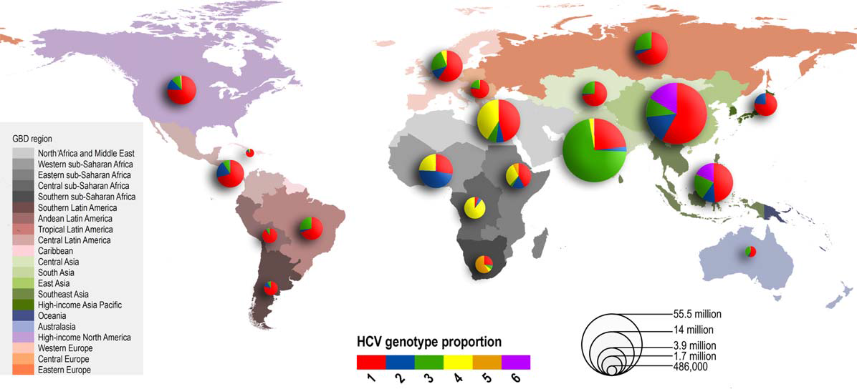
Global Distribution and Prevalence of
HCV Genotypes: US Focus on GT 1
Messina JP et al, Hepatology, 2015; 61: 77-87.
Notes:
GT 1 is the major genotype in the US and will be the focus of this meeting.

Slide 30
AASLD and IDSA: Recommended HCV Regimens for This Patient
Case 1: Easy To Treat Population
34 year old female, with baseline HCV RNA of 850,000 IU/ml and genotype 1b, mild fibrosis and the IL28B CC genotype.
Duration of Therapy (weeks)
 | Genotype 1a |  | Genotype 1b
 | No Cirrhosis | With Cirrhosis* | No Cirrhosis | With Cirrhosis*
Ledipasvir/sofosbuvir (90/400 mg qd) | 12^ | 12 | 12^ | 12
Sofosbuvir (400 mg qd) + simeprevir (150 mg qd) + RBV†‡ | 12 (no RBV) | 24 (without Q80K) | 12 (no RBV) | 24
Ombitasvir/paritaprevir/r (25/150/100 mg qd) + dasabuvir (250 mg bid) + RBV | 12 (with RBV) | 24‡ (with RBV) | 12 (no RBV) | 12 (no RBV)
Daclatasvir (60 mg qd)§ + sofosbuvir (400 mg qd) + RBV | 12 (no RBV) | 24 | 12 (no RBV) | 24
Weight-based RBV (1000 mg [<75 kg] to 1200 mg [>75 kg]).; *Compensated cirrhosis.; †Role of RBV is unclear, awaiting results from larger phase 3 studies for clarification.; ‡12 weeks may be considered for some patients based on prior treatment history.
§Dose may need to increase or decrease when used concomitantly with cytochrome P450 3A/4 inducers and inhibitors,
respectively.; ^ FDA label: consider 8 weeks of therapy if HCV RNA < 6M IU/ml
AASLD and IDSA. http://www.hcvguidelines.org/full-report-view. Version December 11, 2015.

Slide 31
Easy to Treat Genotype 1 Patient
Multiple Pathways to High SVR

Slide 32
Real World Data Confirms High Cure Rates
SVR12 and Relapse Rates for LDV/SOF in HCV G1 Patients
SVR
LDV/SOF
Relapse
Nelson D, et al. HCV TARGET 2015
Notes:
Difference between Relapse and Failure: 1 patient in 12 week group had lack of efficacy- never reached BLOQ, but came close.

Slide 33
Case 2: Hard To Treat Population
68 year old male, genotype 3, cirrhosis and failed prior therapy with PEG-IFN + ribavirin.
AASLD/IDSA recommendations for Gen 3, cirrhosis, TE Patients
 | Sofosbuvir (400 mg qd) + PR for 12 weeks* Daclatasvir (60 mg qd) + sofosbuvir (400 mg qd) + RBV for 24 weeks^
* Likely SVR for thus patient = 85%
^ Likely SVR for this patient= 85%
AASLD and IDSA. http://www.hcvguidelines.org/full-report-view. Version December 11, 2015.

Slide 34
AASLD and IDSA: Recommended HCV Regimens for
Treatment-Naïve Patients (Genotype 2, 3, 4, 5, 6)
Genotype 2
 | Sofosbuvir (400 mg qd) + RBV for 12 weeks (16 weeks is recommended for cirrhotics*) Daclatasvir (60 mg qd)† + sofosbuvir (400 mg qd) for 12 weeks (unable to tolerate RBV)
Genotype 3
 | Sofosbuvir (400 mg qd) + PR for 12 weeks Daclatasvir (60 mg qd)† + sofosbuvir (400 mg qd) for 12 weeks (no cirrhosis) Daclatasvir (60 mg qd)† + sofosbuvir (400 mg qd) + RBV for 24 weeks (cirrhotics*)
Genotype 4
 | Ledipasvir/sofosbuvir (90/400 mg qd) for 12 weeks Sofosbuvir (400 mg qd) + RBV for 24 weeks Ombitasvir/paritaprevir/r (25/150/100 mg qd) + dasabuvir (250 mg bid) + RBV for 12 weeks
Genotype 5
 | Ledipasvir/sofosbuvir (90/400 mg qd) for 12 weeks
Genotype 6
 | Ledipasvir/sofosbuvir (90/400 mg qd) for 12 weeks
Sofosbuvir 400 mg qd. Weight-based RBV (1000 mg [<75 kg] to 1200 mg [>75 kg]).
PR: pegIFN + RBV.
*Compensated cirrhosis.
†Dose may need to increase or decrease when used concomitantly with cytochrome P450 3A/4 inducers and inhibitors,
respectively.
AASLD and IDSA. http://www.hcvguidelines.org/full-report-view. Version August 7, 2015.

Slide 35
Special Populations: Not so Special!
Decompensated cirrhosis
  SOF + LDV: SVR =72-96%¹
  SOF Velpatasvir + RBV 12 wks: SVR= 94%².
Post liver transplant
  SOF + SMV + RBV: SVR = 86% ³
  3D + RBV x 24 weeks: SVR = 96%⁴
  SOF + DCV x 24 weeks = SVR= 97%⁵
HIV-HCV co-infection
  SOV + LDV: SVR = 100%⁶
  3D + RBV x 12 weeks: SVR = 93.5%⁷
  SOF + DCV x 12-24 weeks SVR= 94%⁸
Chronic Kidney Disease
  Grazoprevir + Elbasvir 94-99%⁹
  Manns M, et al. EASL 2015. Abstract G02. 2. Curry MP, et al. N Engl J Med. 2015 3..Brown B, AASLD 2014; 4. Kwo P et al EASL 2014 abstract o114; 5Coilly A, et al. EASL 2015. Abstract G15; 6. Osinusi, et al. EASL 2014.; 7 Sulkowski M et al Melbourne, 2014 ; 98 Poordad F, et al. EASL 2015. Abstract LO8; 9 Roth D, et al. EASL 2015. Abstract LP02

Slide 36
Building the Optimal Treatment Regimen
Extremely high efficacy (>95%)
Minimal toxicity
Minimal drug-drug interactions
Once daily dosing and no ribavirin
Pangenotypic
Short duration
Low cost
Is this type of drug on the horizon ?

Slide 37
ASTRAL-1 and 3: SVR12 With Sofosbuvir/ Velpatasvir for 12 Weeks in GT1, 2, 3, 4, 5, 6 HCV
Highly effective across all genotypes and stages of liver disease
AE profile similar to placebo
Astral-1
Astral-3
99
98
99
100
100
97
100
95
100
80
60
SVR12 (%)
40
20
618/
624
206/
210
117/
118
104/
104
116/
116
34/
35
41/
41
264/
277
n/N =
0
3
All Pts
1a
1b
2
4
5
6
HCV Genotype
Feld JJ, et al. N Engl J Med. 2015; Foster GR, et al. N Engl J Med. 2015
Notes:
BL, baseline; GT, genotype; HCV, hepatitis C virus; SVR, sustained virologic response; Tx, treatment.

Slide 38
Screening of Baby Boomers With Linkage to Care May Prevent >120,000 Deaths Due to HCV Infection
1,070,840 new cases of HCV identified with birth-cohort screening
552,000 patients treated
364,000 patients cured*
121,000 deaths
averted†
  Birth-cohort screening in primary care would identify 86% of all undiagnosed cases in the birth cohort, compared with 21% under risk based screening¹
  Cost effectiveness of HCV screening is comparable to cervical cancer or cholesterol screening
Markov chain Monte Carol simulation model of prevalence of hepatitis C antibody stratified by age, sex, race/ethnicity, history of injection drug use, and natural history of chronic hepatitis C.
*With pegylated interferon and ribavirin plus DAA treatment.
†Deaths due to decompensated cirrhosis or hepatocellular carcinoma within 1945-1965 birth cohort. 470,000 deaths under birth cohort screening vs 592,000 deaths under risk-based screening
1. Rein D et al. Ann Intern Med. 2012;156(4):263-270; 2. McGarry LJ et al. Hepatology. 2012;55(5):1344-1355.
Notes:
Key Point
Studies have shown a decreased rate of liver complications in patients who achieved SVR with pegylated interferon alpha and ribavirin.
Notes
The Hepatitis C Antiviral Long-Term Treatment Against Cirrhosis (HALT-C) trial was a multicenter study of 1145 subjects with advanced chronic HCV who were nonresponders to previous interferon-based treatment.
Although SVR rates in patients with advanced hepatic fibrosis were reduced, rates of HCV-associated complications were significantly lower in subjects achieving SVR with pegylated interferon alpha and ribavirin (n=140) compared with nonresponders (n=309):
Decompensated liver disease: 1.4% vs 13.9%
Liver transplantation: 0.7% vs 11.0%
HCC: 1.4% vs 9.1%
Liver-related death: 0.7% vs 6.8%
Because SVR does not eliminate the risk of complications, continued post-treatment monitoring is necessary in these patients.
Reference
Morgan TR, Ghany MG, Kim HY, et al. Outcome of sustained virological responders with histologically advanced chronic hepatitis C. Hepatology. 2010;52(3):833-844.
Figure
Morgan TR. Hepatology. 2010; 7, Table 3
Bullets
Morgan TR. Hepatology. 2010;52:2,A,2;
7,Table 3
Key Point
Morgan TR. Hepatology. 2010;7,Table 3
Notes Bullet 1
Morgan TR. Hepatology. 2010;2,A,2
Notes Bullet 2
Morgan TR. Hepatology. 2010; 7, Table 3

Slide 39
HCV Linkage-to-Care: Missed Opportunities in a Large Primary Care Setting (2005-2010)
308
38% Received
Care From Specialist
Number of Patients
117
6.8%
Treated
2.6%
Achieved SVR
21
8
HCV RNA
Positive
Seen by
Specialist
Treated
Achieved
SVR
Patients with a positive anti-HCV antibody test and visit to primary care from 2005-2010 (n=566).
Of these patients, 458 underwent HCV RNA testing.
Brown KA, et al. Hepatology. 2013;58(suppl 1):1291A. Abstract 2240.
Notes:
Slide: HCV Linkage-to-Care: Missed Opportunities in a Large Primary Care Setting (2005-2010)
Reference
Brown KA, Nerenz DR, Arkinson R, et al. Barriers to cure for hepatitis C: Data from a large integrated health system. Hepatology. 2013;58(suppl 1):1291A. Abstract 2240.

Slide 40
Overall Summary
HCV has been a remarkable story of discovery
SVR leads to significant improvement in morbidity and mortality on all HCV patients
  Hard to justify restriction of care
Multiple IFN-free options are available
  Increased efficacy (most patients SVR > 90%)
  RBV not required for most regimens
  Fewer side effects and drug-drug interactions
Focus now on diagnosis and linkage to care

